Slide 1
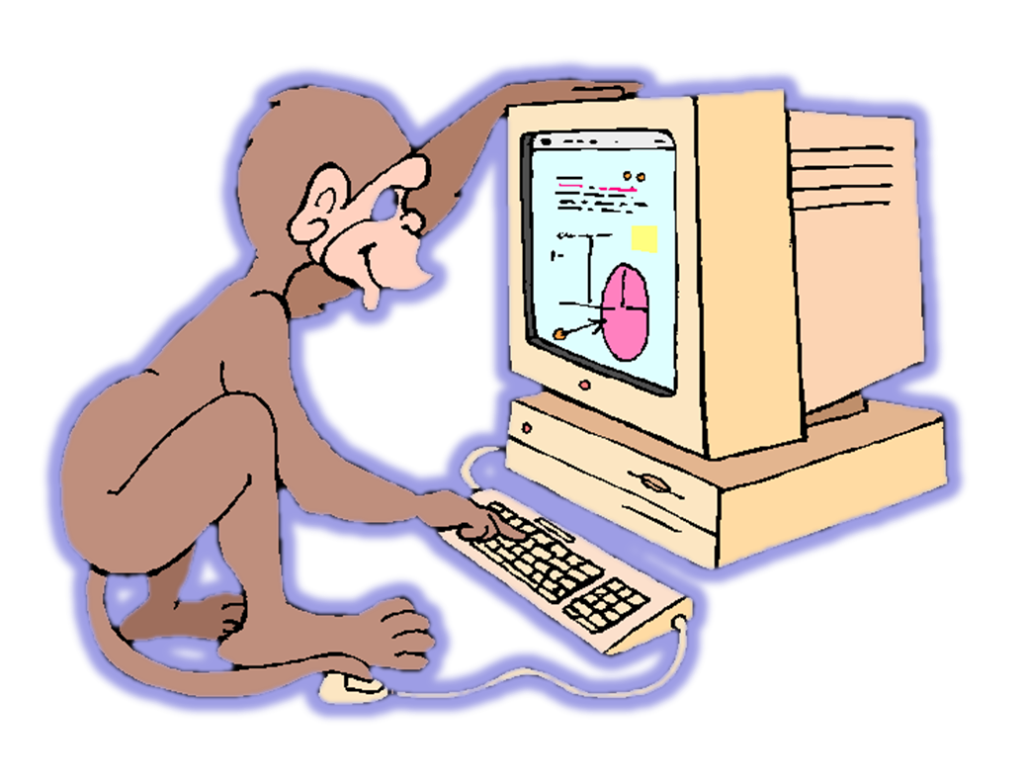
Specification Demo
EKE 749 Group Assignment 2
Team 6, Code Monkeys.
Notes:
Hello everyone.
My name is Dae-Hong Lee.
I belong to Team 6, and our team name is Code Monkeys.
You can see this monkey, and computer. This monkey show our name clearly.
I represent about specification.
I explain what should our team do, and how we construct and progress our project.

Slide 2
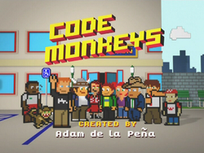

Code Monkeys
Notes:
First, I explain about ‘Code Monkeys’.
‘Code Monkeys’ has two means.
First is an American animated television program in the early 1980s.
Second, A Code monkey is a computer programmer or other person who writes computer code for a living.
This term may be slightly derogatory,
meaning that this developer can write some code.
but this people is unable to perform the more complex tasks of software architecture, analysis, and design
In other words, code monkey means not efficient person.
But, we use this name paradoxically.
We will write code harder than this child.

Slide 3

Introduce
Group name : Code Monkeys
Project name : Monkey Calendar
Notes:
So, our group name is ‘Code Monkeys’.
And our project name is also about monkey.
This monkey seems very cute. Isn’t it?
This monkey cute or not, our project name is ‘Monkey Calendar’.

Slide 4
Contents
Objective
Features
Environment
Notes:
This slide show big picture of my presentation.
First, I introduce objective of this project.
And second, I introduce monkey calendar’s features.
This is consist of basic requirements and additional features.
And last, I explain our task environment.

Slide 5

Objective
Write a calendar and appointment scheduler system.
    Construct features, interface, limitation, etc..
    Add GUI, instead of just text
+ funny things
-> ANDROID
Notes:
The object of this project is writing a calendar and appointment scheduler system.
This system is Constructed by features, interface, limitation, etc…
This is very basic component.
My team intends to add distinctive things which are more enjoyable and fun like fortune, biorhythm, weather.
And we use windowing interface to emphasize on visual impressions.
To make this,
My team will use android.
I will explain this, later.

Slide 6
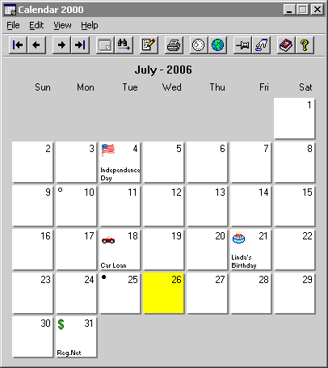
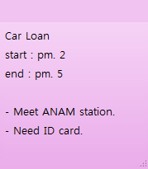
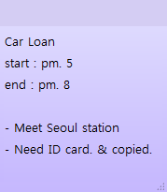
Basic
Printing and Changing appointments
July - 2011
Notes:
We use graphic user interface which is called GUI.
So, I explain Monkey Calendar’s features using animations and pictures.
First, I treat very fundamental calendar’s features.
The picture of this calendar is used just explain.
So our interface will be changed later.
In this picture, calendar prints year, month, day, and date.
This black point means current day,
and when click one day, the color of that day will be changed like this.
It is very basic function of calendar.
If user want record about appointment, click and write that like this.
Like I said, this picture will be changed.
Sure, it is possible to
change appointment or
Clear appointment.

Slide 7

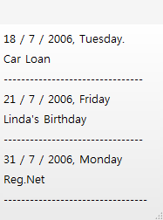
Basic
Listing and Save & Load system
Load
July - 2011
Appointment1.MC
Save
Notes:
Next, if user sets appointments like this,
User can print all appointments for a given year, month, week, or day.
It’s good for seeing all appointments easily.
And we can save & load the set of all appointments to a file like this.
By using save & load system, user can treat various schedule separately.

Slide 8

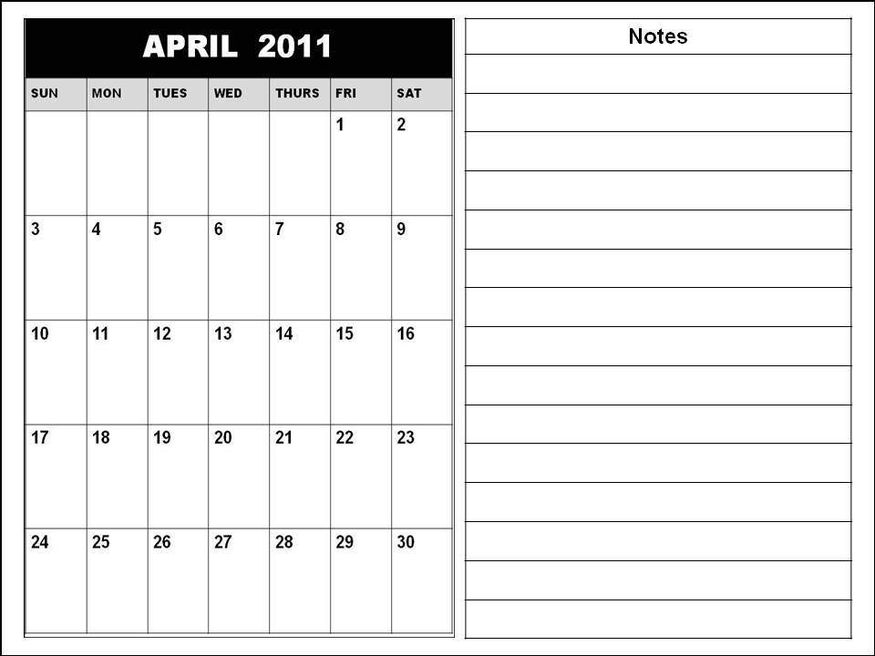
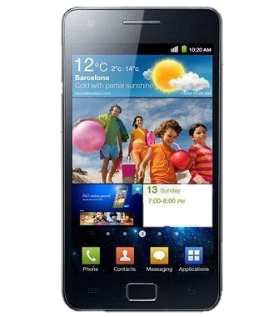
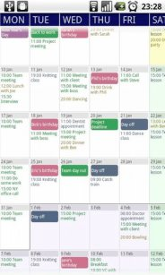
Interface
GUI(graphic user interface) using
android graphic library
Notes:
To use GUI interface, we must select how to show this.
Before I mentioned about it, I said that we decided to use android operating system.
We may using eclipse and we will test virtual machine and smart phone.
Sure, this calendar image is just come from googling. Not ‘Monkey Calendar’.
I think ‘Monkey Calendar’ is maybe better than this one!!

Slide 9
Fields
Adding additional fields
FEBRUARY
Title
Car Loan
Date
2 / 4 / 2011
Start
5 PM
End
8 PM
Location
Seoul station
Participation
Car manager
Need ID card & copied
Description
Notes:
From this slide, I explain about additional function of Monkey Calendar.
So, When we click that date, we see detailed information.
In general, calendar application is consist of name, day, and time like this.
But, we often experience the situation that write appointment which is included location, or participation.
When we go somewhere, we should know where.
And when we meet someone, we should know who.
So, Monkey calendar provides additional fields like location, people.
So user can classifies information easily and sees calendar at a glance.

Slide 10
Repeating
Repeating appointments easily
FEBRUARY
Title
Volunteer Work
Date
2 / 9 / 2011
MARCH
2 PM
Start
End
7 PM
Location
Korea univ.
Participation
Colleague
Description
Sometimes location will be changed.
Every week
Every month
Notes:
When we set appointment, we sometimes set appointment repeatedly.
Monkey Calendar can repeat appointments just click.
We will make checkbox to select repeating or not.
Sure, this interface of check box also can be changed.
Anyway, through this menu, user can repeats appointments every weeks like this.
And~
User also can repeats appointments every month.
It is useful setting appointments like monthly card payment or weekend business report.

Slide 11
Spanning
Setting appointment periodically.
FEBRUARY
Title
MT
Date
2 / 4 / 2011
2 / 4 ~ 2 / 8
Start
2 / 4 5 AM
End
2 / 8 8 PM
Location
Busan
Participation
Friends
Description
Notes:
When we write about going traveling or mid term & final term exam, we should setting period.
Monkey calendar is also good for not one day appointment but also multiple days appointment.
For example, If user assign appointment from Feb 4 to Feb 8, user easily sets this appointment by selecting start with Feb 4 & end with Feb 8.
This is also useful setting appointment like homework date, vacation season.

Slide 12
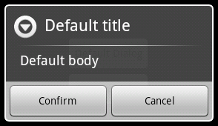
Notification
Reporting overlapped appointment.
FEBRUARY
Title
Volunteer Work
Title
Team meeting
Date
2 / 4 / 2011
Date
2 / 4 / 2011
Start
2 PM
Start
5 PM
End
7 PM
End
8 PM
Location
Korea univ.
Location
Room. 312
Participation
Colleague
Participation
Warning
Time is overlapped another
appointment. Is it OK?
Sometimes location will be changed.
Description
Description
Notes:
When we make an appointment, we sometimes make a mistake about appointment date or time.
Monkey calendar reports if two appointments are at the same time.
For example, User set appointment Feb 4 from 5 PM to 8 PM.
But if user writes to set another appointment which is overlapped before appointment,
System shows message about this.
If user doesn’t care about it, just passes this message.
And if user wants to set overlapped appointment, just clicks confirm.

Slide 13
Special day
Holiday & Lunar calendar
MAY
Lunar Calendar
4 / 4 / 2011
Children’s day
Lunar Calendar
4 / 8 / 2011
Buddha's Birthday
Lunar Calendar
4 / 18 / 2011
Notes:
Next, It’s about holiday & lunar calendar.
It first shows holiday.
We can see not only Sunday, but also children’s day and buddha’s birthday easily.
And if you want,
You can see Lunar calendar.
Calendar is consist of lunar calendar, & solar calendar.
We easily know that solar calendar is almost main of calendar.
But we sometimes need lunar calendar like chuseok & buddha’s birthday.
And then, this function is useful.

Slide 14
Tasknote
Adding stationary tasknote
MARCH
July
Keep household accounts
Write self-introduction
Repair notebook
Notes:
Next, Monkey calendar has additional tasknote.
Sometimes we get important information.
We want to see this information as much as possible.
By using this tasknote, user can treat important things easily.
Because, although moth is changed, tasknote doesn’t be changed.
Additionally, tasknote always keep staying under the calendar like this.
So, user can always see this part.

Slide 15
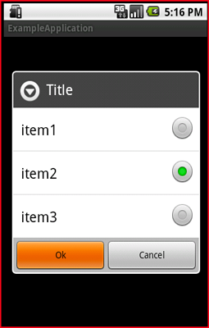
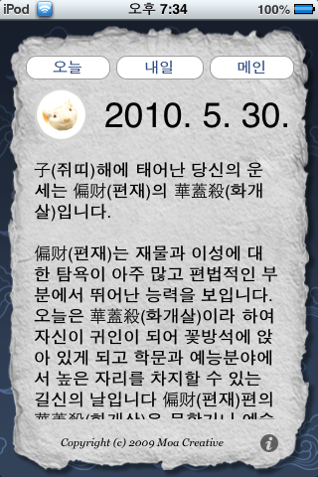
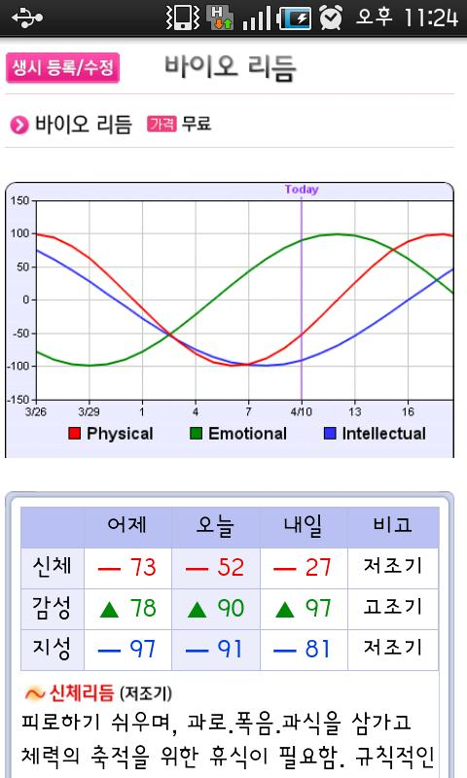
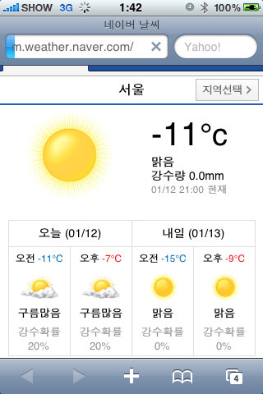
Day Information
Providing various information day-by-day
Day-Info
Weather
Biorhythm
Fortune
LINK
Notes:
Every day, Monkey calendar provides funny information.
This application provides three information every day.
User can see three menu, Biorhythm, weather, and fortune of today.
If user clicks weather,
Application shows that day’s weather through link.
And if user clicks Biorhythm
User also can see his fortune.
Through this simple link, this application play a role as a interest.

Slide 16
Multiple Language
Localization to current region(optional)
FEBRUARY
MARCH
Volunteer Work
Name
Volunteer Work
Name
Day
3 / 9 / 2011
Day
2 / 9 / 2011
Start
Pm.. 2
Start
Pm. 2
Pm. 7
End
Pm. 7
End
Location
Korea univ.
Location
Korea univ.
People
Colleague
People
Colleague
Sometimes location will be changed.
Sometimes location will be changed.
Description
Memo
Notes:
From this slide, I introduce optional features.
Because i cannot sure providing this function,
Monkey Calendar provides English and Korean.

Slide 17
Multiple Language
Localization to current region(optional)
FEBRUARY
내용
3월
Volunteer Work
제목
Volunteer Work
Name
일
월
화
수
목
금
토
날짜
3 / 9 / 2011
Day
2 / 9 / 2011
시작시간
Pm. 2
Start
Pm. 2
Pm. 7
끝 시간
Pm. 7
End
장소
Korea univ.
Location
Korea univ.
사람
Colleague
People
Colleague
Sometimes location will be changed.
Sometimes location will be changed.
추가 설명
Memo
Notes:
so user can select language.
If user selects Korean, almost name of menu will be changed like this.
And we plan to localize.
Through localization, people can apply the time of somewhere, immediately.
But, before I said, this is just optional plan.
if we have sufficient time, we will make this.

Slide 18
Environment
Android version : 2.1
Resolution : 800 x 480 WVGA
Input device : touch, virtual keyboard
Notes:
Last, I explain about our task environment.
Our application will be developed on Android 2.1.
2.1 a.k.a. Éclair is most popular version of android.
And except one person we have Android 2.1 phones in our team.
To test our application we will test our own phones. But all of them has Éclair version.
And this resolution is widely used in these days.
Definitely the phones support touch screen. So User Interface will be based on touch screen input device.

Slide 19

Ask me anything!
Notes:
My presentation is end.
Thank you for listening this presentation.
If you want, ask me whatever.

